Slide 1
Discriminant Functions

Slide 2
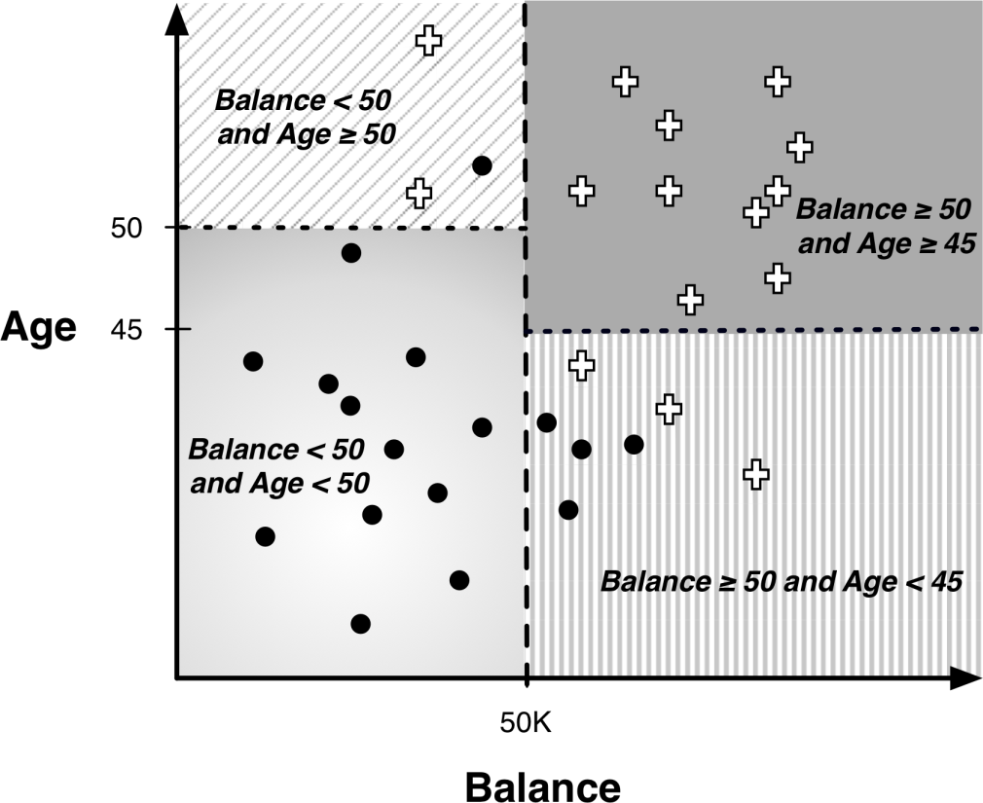
Decision Boundaries (Trees)

Slide 3
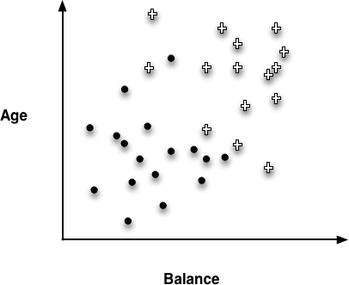
Instance Space

Slide 4
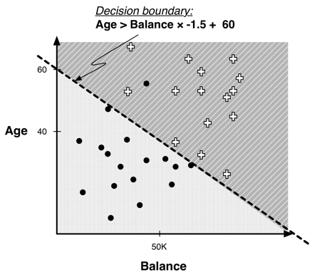
Linear Classifier

Slide 5
Example of Classification Function
Linear discriminant:
We now have a parameterized model: the weights of the linear function are the parameters
The weights are often loosely interpreted as importance indicators of the features
A different sort of multivariate supervised segmentation
The difference from DTs is that the method for taking multiple attributes into account is to create a mathematical function of them

Slide 6
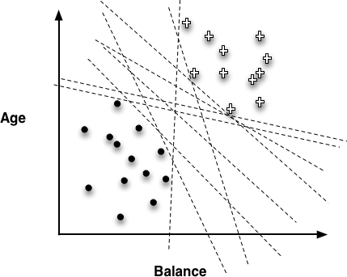
Choosing the “best” line

Slide 7
Objective Functions
“Best” line depends on the objective (loss) function
Objective function should represent our goal
A loss function determines how much penalty should be assigned to an instance based on the error in the model’s predicted value
We want to minimize the loss function (or error)
The best model is the one with the minimum sum of errors
Examples of objective (or loss) functions:
Linear regression, logistic regression, and support vector machines are all very similar instances of our basic fundamental technique:
They all fit a linear model to data
The key difference is that each uses a different objective function

Slide 8
Loss Functions
Zero-one loss assigns a loss of zero for a correct decision and one for an incorrect decision
Squared error specifies a loss proportional to the square of the distance from the boundary
Squared error loss usually is used for numeric value prediction (regression), rather than classification
The squaring of the error has the effect of greatly penalizing predictions that are grossly wrong

Slide 9
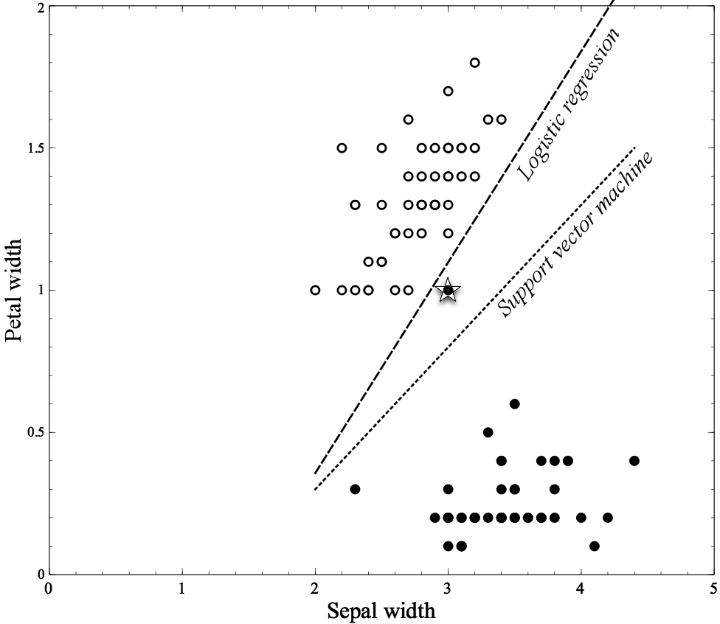
Same Problem, Two Classification Algorithms

Slide 10
SVM and It’s Objective Function

Slide 11
Choosing the “best” line

Slide 12
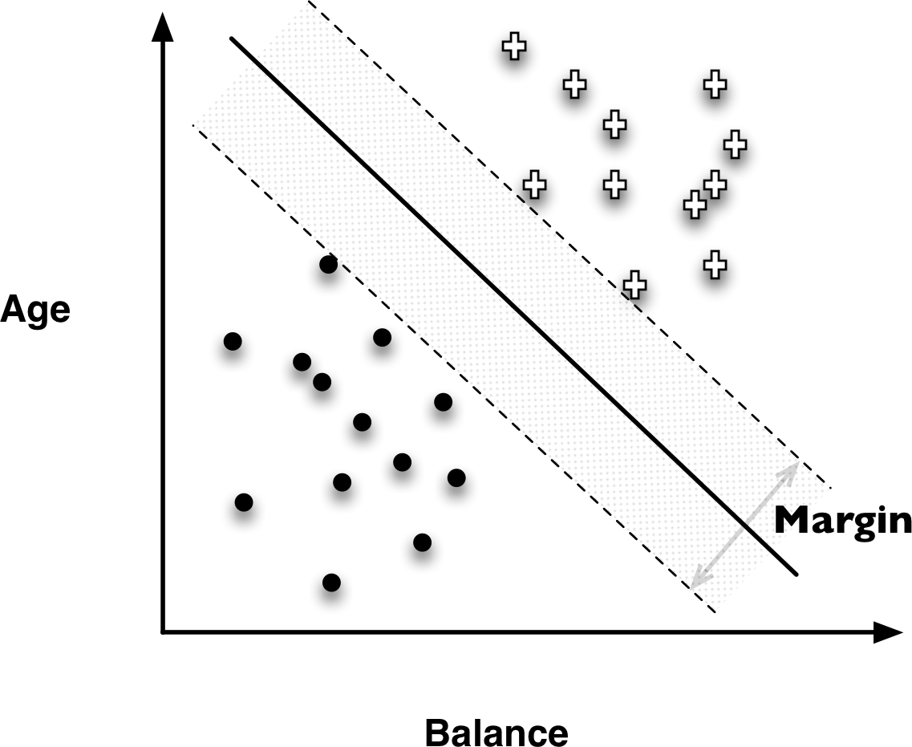
Support Vector Machines (SVMs)

Slide 13
Support Vector Machines (SVMs)
Linear Discriminants
Effective
Use “hinge loss”
Also, non-linear SVMs

Slide 14
Hinge Loss functions
Support vector machines use hinge loss
Hinge loss incurs no penalty for an example that is not on the wrong side of the margin
The hinge loss only becomes positive when an example is on the wrong side of the boundary and beyond the margin
Loss then increases linearly with the example’s distance from the margin
Penalizes points more the farther they are from the separating boundary

Slide 15
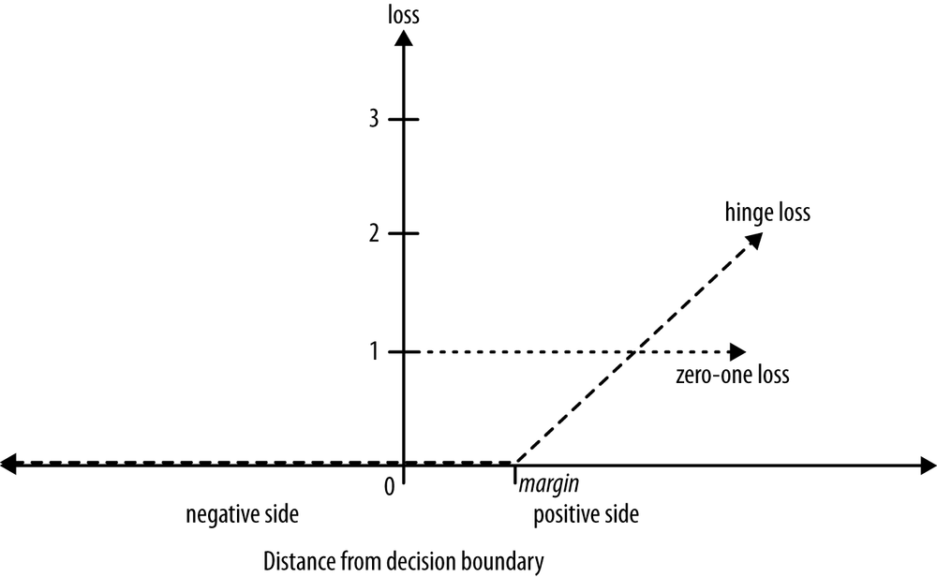
SVM Hinge Loss Functions

Slide 16
Logistic Regression and Its Objective Function
We want to estimate not only which class an sample belongs to, but also the probability.
We can do this with the same framework for fitting linear models to data, by choosing a different objective function.
The most common procedure of this approach is called logistic regression

Slide 17
Logistic regression is a misnomer
The distinction between classification and regression is whether the value for the target variable is categorical or numeric
For logistic regression, the model produces a numeric estimate
However, the values of the target variable in the data are categorical
Logistic regression is estimating the probability of class membership (a numeric quantity) over a categorical class
Logistic regression is a class probability estimation model and not a regression model

Slide 18
Linear Classifier Function as Probability?
?

Slide 19
From f(x) to p(x)

Slide 20
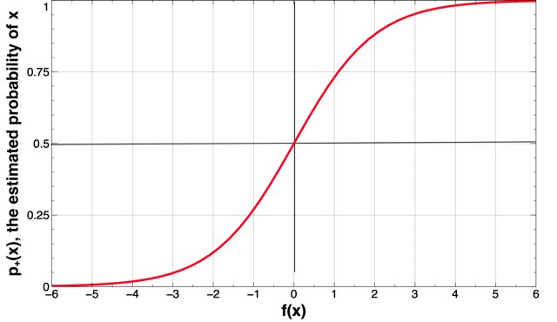
Logistic regression (“sigmoid”) curve

Slide 21
Logistic Regression Objective Function
The g function gives the model’s estimated probability of seeing x’s actual class given x’s features.
The model (set of weights) that gives the highest sum is the model that gives the highest “likelihood” to the data—the “maximum likelihood” model.

Slide 22
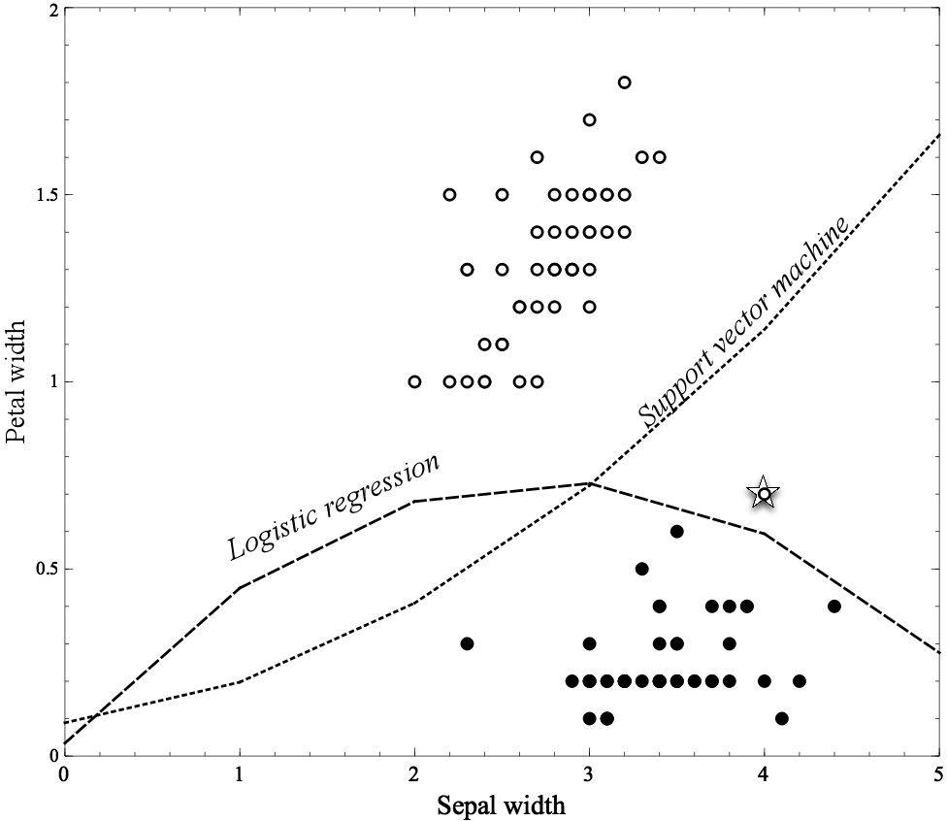
Non-linear Functions
Linear functions can actually represent nonlinear models, if we include more complex features in the functions
Use a “polynomial kernel” considering “higher-order” combinations of the original features, such as squared features, products of features, etc.

Slide 23
Non-linear Functions
Using “higher order” features is just a “trick”
Common techniques based on fitting the parameters of complex, nonlinear functions:
Non-linear support vector machines and neural networks
Nonlinear support vector machine with a “polynomial kernel” consider “higher-order” combinations of the original features
Squared features, products of features, etc.

Slide 24
Linear Models versus Tree Induction
What is more comprehensible to the stakeholders?
Rules or a numeric function?
How “smooth” is the underlying phenomenon being modeled?
Trees need a lot of data to approximate curved boundaries
How “non-linear” is the underlying phenomenon being modeled?
If very, much “data engineering” needed to apply linear models
How much data do you have?!
There is a key tradeoff between the complexity that can be modeled and the amount of training data available
What are the characteristics of the data: missing values, types of variables, relationships between them, how many are irrelevant, etc.
Trees fairly robust to these complications

Slide 25
Homework
Data:
Homework3.csv contains information of static analysis of 99 binary files. 50 files are benign/good and 49 are malicious/bad.
The target variable is “label”; its value is either “good” or “bad”. All other columns are features.
Task:
Build a classifier with decision tree. Use the the whole data set for both training and testing purpose. Submit your best model in terms of prediction accuracy.
What are the most 10 important features? Why?
Build two logistic regression models: one with all available features and one with the 10 most important features. Compare their prediction accuracies.
Homework 3 is due on Oct. 2nd.

